Slide 1
Getting started with Machine Learning
CIS662, August 28, 2023

Slide 2
Class Exercise
Task: to predict how much rain is expected tomorrow in Syracuse.
How would we address this task without knowing anything about Machine Learning?

Slide 3
Class Exercise
Task: to predict how much rain is expected tomorrow in Syracuse.
How would we address this task with Machine Learning?

Slide 4
Overview
What it’s all about
Models
Algorithms
Architecture
Parameters
Applications

Slide 5
Reality
Processes generate data!
Some processes are deterministic; most are not.
Some processes involve the actions of autonomous agents.
Some contain feedback loops, so that outputs depend on old inputs, recent outputs, and perhaps external reinforcement (reward).
Noise may be inherent or the result of measurement.
The nature of a process may change with time.
Notes:
Natural processes (referred to here as "systems") generate real data as outputs, using real external inputs, the prior history of the process itself, external constraints and conditions that may vary, sources of noise (relating to measurement as well as the process itself), and feedback from the environment regarding the recent input-output behavior of the system.

Slide 6
Possible goals of Machine Learning
Prediction (of outputs of the process, in response to new inputs)
Process simulation (developing a functional description)
Process understanding (how the real process works)
Notes:
From this perspective, Machine Learning has been stated to have one or more of the following goals: (a) prediction, (b) process identification, and (c) process understanding.

Slide 7
Prediction (in the generic sense, not just forecasting)
Given: a new input
Goal: estimate what the corresponding system output should be.
These estimations may happen over time, depending also on recent inputs that may not be new.

Slide 8
Prediction: Archeology examples
Scientists have newly excavated some bones, and pose questions such as:
Which group of bones belong to the same animal? (Grouping, clustering…)
To which species does a newly excavated bone belong? (Classification)
What is the probability that an excavated bone belongs to T. Rex?
What is the predicted length of the leg of the animal to which an excavated partial thigh bone belongs?
In which direction should we dig next to uncover more bones?

Slide 9
Prediction is not process simulation!
We may accept good estimates, even if the logic or the actual relationship between input and output variables remains unknown.
Example: in some ML approaches, multiple models are developed, possibly contradicting each other, and we rely on an overall prediction that aggregates the results of each of these models.
Predictions may be performed without constructing any models, e.g., in nearest neighbor approaches, we simply rely on the expectation that similar inputs produce similar outputs, without any pretense of learning why that happens.
Notes:
After a specific prediction has been generated, we may (post-hoc) try to construct an explanation ("why this prediction") by summarizing aspects of the models that contributed most to the final prediction of the ensemble; but this is not the same as describing the general functional relationship between inputs and outputs.

Slide 10
Process Simulation
Goal: construct a “model” (mapping from inputs to outputs) that provides good estimates in all cases that fall in the applicable domain of input data.
The model describes all the computations that need to be carried out to obtain a reasonable estimate of the system outputs, when given the inputs.
With modern ML systems, especially with deep learning, the model may be very complex, involving the successive composition of numerous component nonlinear functions, which may not be amenable to any short summary.
Notes:
The model is really just a description of all the computations that need to be carried out to obtain a reasonable estimate of the system outputs, when given the inputs to the system. With modern ML systems, especially with deep learning, such a description may be very complex, involving the successive composition of numerous component nonlinear functions, which may not be amenable to any short summary. At best, we may say that the behavior of the model does accurately simulate the natural process, and even say what may happen if one input variable is increased a little. But we don't really say why. In the sense of Greg Chaitin, "comprehension is compression": lack of a short description of the model indicates that we haven't really understood what's going on in the model (or the real system being simulated). The capabilities of most ML systems are restricted in this manner. As a consequence, the limitations of applicability of the learned model are also not understood, e.g., the model may behave counter-intuitively when the new inputs are substantially different from the old ones.

Slide 11
Process Simulation is not “Understanding”!
At best, the model does accurately simulate the natural process, and say what may happen if one input variable is increased a little.
But we don't really say why.
In the sense of Greg Chaitin, "comprehension is compression”!
Lack of a short description of the model indicates that we haven't understood what's going on.
The limitations of applicability of the learned model are also not understood, e.g., the model may behave counter-intuitively when the new inputs are substantially different from the old ones.

Slide 12
“Understanding” = being able to …?...

Slide 13
A Spoonful of Philosophy
How do we distinguish scientific vs. non-scientific hypotheses?
Verifiability
Falsifiability
[The issue is not whether something is true or false.]

Slide 14
A Spoonful of Philosophy
How do we distinguish scientific vs. non-scientific hypotheses?
Verifiability
Falsifiability
How about the following? [The issue is not whether something is true or false.]
The human soul weighs 21 grams.
When a person dies, their weight decreases by 21 grams.
My neural network is prettier than yours.
This neural network has fewer parameters than that one.
Computers can be conscious.
This software can generate responses that simulate human responses well.

Slide 15
“Understanding” = being able to …
Identify “features” (combinations of input attributes)
Determine relative importance of attributes and features
Construct causal explanations that can be verified
Represent uncertainty associated with observations or inferences
Deduce the limitations of an approach or model
It is very difficult to know whether understanding has been achieved!

Slide 16
What shall we do in ML?
Most of the time, we begin with a specific class of models (e.g., feedforward neural networks with one hidden layer).
Each model has some ”parameters” (e.g., connection weights in the neural network).
Parameter values are often randomly initialized.
We use a “learning algorithm” to modify parameter values iteratively until: (a) results are satisfactory; or (b) results stop changing; or (c) computational resources are exceeded.

Slide 17
ML as a high-level meta-algorithm
Choose a class of models, based on past experience;
Initialize parameter values of one or more models;
While (results are unsatisfactory) and/or (results continue to change/improve over some number of iterations) and/or (number of iterations are not excessive), do:
Use the available data to modify model parameter values;
4. Interpret the resulting models (with updated parameter values).

Slide 18
ML is Data-Driven!
Knowledge required to solve (new) problems must come from data.
In some applications, experts can be queried (knowledge elicitation).
We often begin with a preconceived notion of what the knowledge model must look like.

Slide 19
ML is Data-Driven!
Knowledge required to solve (new) problems must come from data.
In some applications, experts can be queried (knowledge elicitation).
We often begin with a preconceived notion of what the knowledge model must look like.
If no rough notion is available, we hypothesize, based on other problems that we have solved before.

Slide 20
ML is Data-Driven!
Knowledge required to solve (new) problems must come from data.
In some applications, experts can be queried (knowledge elicitation).
We often begin with a preconceived notion of what the knowledge model must look like.
If no rough notion is available, we hypothesize, based on other problems that we have solved before.
Fine-tuning requires looking at available data.
If the result is unsatisfactory, we revise our model, sometimes drastically.
Machine learning must accommodate for these processes!

Slide 21
Models
Models approximate reality using equations, figures, diagrams, etc.
Models can be tested against data.
Evaluation criteria depend on the problem.
Examples of models:
Differential equations
Production rules
Hidden Markov models
Feedforward Neural Networks
Associative networks
Decision trees

Slide 22
Learning Algorithms
Learning algorithms use data to determine characteristics of the model architecture, and to modify model parameters.
Architecture learning examples:
How many layers and nodes in a feedforward neural network?
How many rules, and of what kind, in a production system?
Parameter learning examples:
Coefficients in an equation
Weights in a neural network

Slide 23
Class Exercise
Learning task: to predict how much rain is expected tomorrow.
Questions:
What data can be used?
What kind of model?
What details of the model architecture need to be determined?
What are the parameters to be learnt?

Slide 24
What kind of data?
Unsupervised: no labeled data
Supervised: when substantial amount of labeled data is available
Semi-supervised: a little labeled data, much more unlabeled data
Reinforcement-driven: the results of an action can be evaluated

Slide 25
Class Exercise
Learning task: to predict how much snow is expected tomorrow.
What data can we use?
Is this supervised/unsupervised/semi-supervised/reinforcement learning?

Slide 26
What should we look for when deciding on criteria to evaluate learning?
Easy to compute
Meaningful & relevant for the problem we want to address
Mathematically justifiable (not totally arbitrary)
Unaffected by:
Anomalies (e.g., a seemingly healthy young person who succumbs to Covid)
Noise (due to natural processes or measurement errors)
Dimensional scaling (e.g., measuring height in inches vs. metres)
Choice of subset of data is used for learning
Irrelevant dimensions of data (e.g., SUID in predicting grade)

Slide 27
Criteria for evaluation
Mean squared error (and other norms)
Classification accuracy (possibly weighted)
Confusion matrix: showing different kinds of errors (i.e., how many data points of each class are classified as belonging to another)
Cost, possibly giving different weightage to different kinds of errors (e.g., misclassifying a tiger cub’s image as a kitten is not as bad as a dog)
Distances between points clustered together (e.g., distances from neighbors, boundaries, centroids of clusters)
Information theoretic (e.g., cross-entropy, Kullback-Leibler divergence, perplexity)
Multi-objective (weighted sum vs. domination)

Slide 28
Class Exercise
Learning task: to predict how much rain is expected tomorrow.
Assume we have somehow accomplished learning.
How would we evaluate the result of learning?

Slide 29
Training vs. testing vs. cross-validation
Training: subset of data used to learn values of model parameters.
Testing (Validation): a different subset of data used to evaluate the model parameters obtained by training.
Cross-validation (repeated resampling):
For n trials, do:
Split data set again into training and test subsets;
Train;
Test;
Combine the testing results of all trials.

Slide 30
One approach to avoid over-training
Divide data set into three subsets (training, validation, testing).
Repeat:
Perform another iteration of training;
Compare performance on training set and validation set
Until validation performance begins to worsen over successive iterations;
Evaluate the trained model on the testing subset.

Slide 31
Learning Approaches
Point-based (e.g., gradient descent, hill climbing, …)
Analogy: asking a doctor for his diagnosis
Ensemble (combining results from multiple models trained separately)
Analogy: asking ten doctors for their diagnoses, selecting the majority opinion
Population-based (e.g., evolutionary)
Analogy: asking ten doctors to sit together and discuss the patient’s case, revising their opinions by listening to others, until a consensus is reached

Slide 32
Need to choose models and learning algorithms
The same problem may be addressed using diﬀerent models!
E.g., a decision tree or a neural network may be used for a classification problem.
The same model’s parameter values can be estimated using diﬀerent learning algorithms.
E.g., backpropagation or evolutionary strategies may be used for training a neural network’s weights.

Slide 33
Domain-specific information is important!
For example, consider three short-term forecasting problems.
Finance: A company’s stock price is likely to be about the same tomorrow as today. (Why?)
Clothing: I am not likely to wear the same shirt on Thursday as Tuesday! (Why?)
Weather: If it snows today, will it snow tomorrow?

Slide 34
No Free Lunch Theorems [Wolpert and Macready, 1996-7]
Paraphrased: When all possible functions are equally likely, all search algorithms (attempting to find the desired function from these) are equally good.
Proof: For every example where algorithm 1 does better than algorithm 2, we can construct a counter-example where 1 is worse.
Caveat: this may not be the case if the algorithms are adaptive, or if we restrict ourselves to examples that arise from natural or reasonable processes (with nice properties such as continuity).
In practice: assume that an algorithm that worked well for one problem will also work well for other similar problems.

Slide 35
Model selection criteria
Adequacy and expressive power (what it is capable of representing);
Number of trainable parameters;
Information complexity: number of bits needed to describe the model;
How to find the right settings for hyper-parameter values;
Robustness: what happens if a part of the model “fails”, or the input data is noisy, or the environment changes;
Quality of solutions obtained;
Computational eﬀort required to obtain solutions;
Ability to represent problem-specific knowledge; and
Ability to build a hardware implementation.

Slide 36
On model complexity
Occam’s razor: prefer simpler models, with fewer parameters
Avoid over-fitting
Expected to perform better on test data
But: what if the more complex model gives better quality results, and obtains them faster?
We must consider the tradeoff!

Slide 37
Amount of data vs. number of parameters
Rule-of-thumb used by statisticians: amount of data needs to be at least ten times the number of trainable parameters.
Theoretical results (for neural networks): …exponential…

Slide 38
Strategies for finding the right size model
Start small, and grow (iteratively).
Start big, and prune (iteratively).
Regularize: add a size penalty term to the loss function (or other quantity being optimized).

Slide 39
Local Search
While (… you are not exhausted or …) do:
Explore immediate neighborhood of current candidate solution, trying to find a better one.
Most learning algorithms fall into this simple paradigm!
Gradient Descent
Hill climbing
Greedy algorithms

Slide 40
Gradient Descent
If minimizing a loss function, parameters Θ are modified in a direction opposite to the first derivative (gradient)
Θ_{t+1} = Θ_{t} – c. d(loss)/dΘ_{t}
The result decreases the loss by a small amount.
This process is repeated, each time recalculating the gradient.
The error back-propagation algorithm used for training feedforward neural networks implements this systematically, beginning with the layer of weights closest to the outputs, and working backwards towards the inputs.

Slide 41
Greedy or best-first or hill-climbing algorithms
If the problem is not continuous, a gradient may not exist, but we may still pretend that it does, assuming linear behavior locally at each point.
Repeat
Examine all “neighbors” of the current state;
Choose the best neighbor
Until computational constraints are exceeded.

Slide 42
Well-known problem…
If a function being optimized has multiple local optima, gradient descent (and hill-climbing, etc.) can only find the nearest one, and search stops well before reaching the best possible solution (global optimum).
This motivates other “global search” algorithms such as evolutionary algorithms and simulated annealing.

Slide 43
Example problems from Finance
Classification (e.g., recognizing whether to give credit to a loan applicant)
Function approximation (e.g., deciding what interest rate to charge a loan applicant with a known risk profile)
Forecasting (e.g., predicting next year’s interest rates based on previous years’ interest rates and other financial/ fiscal/ political/ economic information)
Optimization (e.g., determining how much of different mutual funds to purchase in order to maximize returns based on a customer’s risk tolerance)

Slide 44
Evaluating 2-class classification performance in terms of True/False Positives/Negatives
Confusion matrix: [[TP FN][FP TN]]
Sensitivity (or Recall) = TP/(TP + FN ),
Specificity = TN/(TN + FP ), and
Precision = TP/(TP + FP ).
Accuracy = (TP + TN )/(TP + FP + TN + FN ),
F1 Score = (2TP )/(2TP + FN + FP ), and
Positive Likelihood Ratio = TP (FP + TN )/FP (TP + FN ).
[Note: “Positive” often means “bad” in medical/financial problems!]

Slide 45
Class Exercise
What about multi-class problems?
Accuracy=?

Slide 46
Class Exercise
Assume 90 “non-fraudulent” (negative), and 10 “fraudulent” (positive) transactions.
Which of the following algorithms is “better”?
Algorithm 1: TN=90, FN=10, TP=0, FP=0, Accuracy=90%
Algorithm 2: TN=70, FN=0, TP=10, FP=20, Accuracy=80%
CONCLUSION?

Slide 47
Class Exercise
Assume 50 patients with Covid (Positive class), and 50 without Covid (Negative class).
Which of the following Covid tests is “better”?
Test 1: TP=50, FP=10, TN=40, FN=0, Accuracy=90%
Test 2: TP=45, FP=5, TN=48, FN=2, Accuracy=93%
CONCLUSION?

Slide 48
Suggestions
Instead of just Accuracy, we need to use other measures appropriate for the problem.
Specific strategies must be used to increase the emphasis given to the class with fewer points, or for which errors are more worrisome, e.g.,
Modifying the loss function, e.g., with asymmetric penalties
Over-sampling the smaller (or more important) class
Under-sampling the larger (or less important) class—but we may lose useful information when we ignore some data

Slide 49
MSE vs. Accuracy for classification problems
Assume that we’d like to maximize accuracy for a classification problem (e.g., character recognition, with equal number of examples for each character).
Does minimizing MSE guarantee maximizing accuracy?
What are the implications for using backpropagation (or other gradient descent procedures) to address classification problems?

Slide 50
Other concerns for classification problems
The output of a neural network is not a probability! Calibration may be possible, e.g., “what fraction of data belong to class 1 when an NN output is in the range 0.7-0.8”?
Noise: training data may be corrupted by noise or errors.
Bias: experts have subjective opinions that bias the data they provide; training data may reflect bad choices made by humans.
Corruption of data: normalization or other deliberate changes to data may result in loss of information needed for learning.
Extrapolation is notoriously more difficult than interpolation.

Slide 51
Anomaly detection vs. classification
In some problems, one “normal” class is well defined, while the other “abnormal” class is only defined in terms of data points being very different from those of the normal class.
Within the abnormal class, there may be drastic differences between points!
For such problems, choosing a classic feedforward neural network model would not help.
Instead, modeling the normal class using clusters would be better, followed by estimating for each point the probability that it belongs to the normal class’s clusters.

Slide 52





Classification with clusters (and anomalies)

Slide 53
When clustering is used…
We must balance between three criteria:
maximizing inter-cluster distance,
minimizing intra-cluster distance,
minimizing the number of clusters.
Inter-cluster distance may be defined in different ways (e.g., distance between centroids, or distance between cluster boundaries) and may also have to account for the incommensurability of different dimensions (e.g., human height in meters, human weight in kilograms).
Intra-cluster distance may focus on average or maximum distances between points in a cluster.

Slide 54
If you are evaluating a new algorithm or model, what is the “straw man” for comparison?
Classification: linear perceptron; support vector machine; small feedforward neural network trained with backpropagation; decision tree; random forest
Function approximation: linear regression; logistic regression; support vector regression; small feedforward NN (with backpropagation)
Forecasting/prediction over time: no change model; short-term average; long-term average; seasonal average; linear trend model; ARMA; ARIMA; LSTM/GRU neural network

Slide 55
How to show results
Most algorithms show fast improvements in early iterations and slow or sporadic improvements later. Logarithmic plots are better than linear plots.
Visual comparisons across two separate graphs are hard. Show multiple plots on the same graph, using different colors, dashed/dotted lines, etc.
The reader may not know what conclusion is to be drawn from a graph or table. State the conclusion clearly.
Tables with many numbers are hard to read. Avoid using too many digits; approximate instead (e.g., “12.1k” instead of “12,127.8149”).
Each trial with an algorithm may yield different results. Hence average across many trials (preferably 30), and also show standard deviations.
Sometimes extreme values skew the averages. The median is then more informative than the mean.

Slide 56
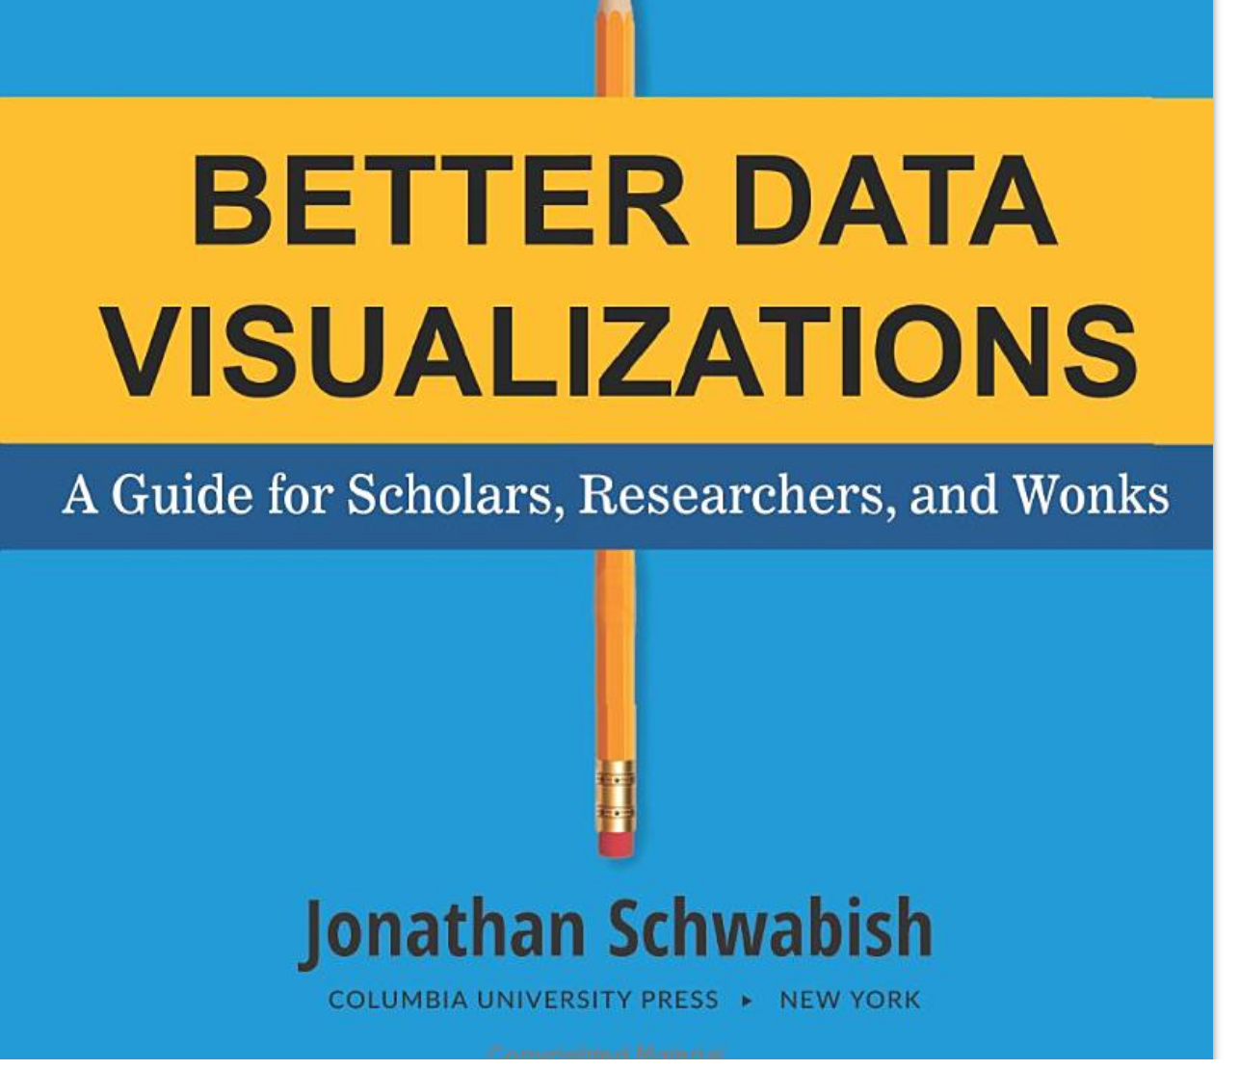

Slide 57
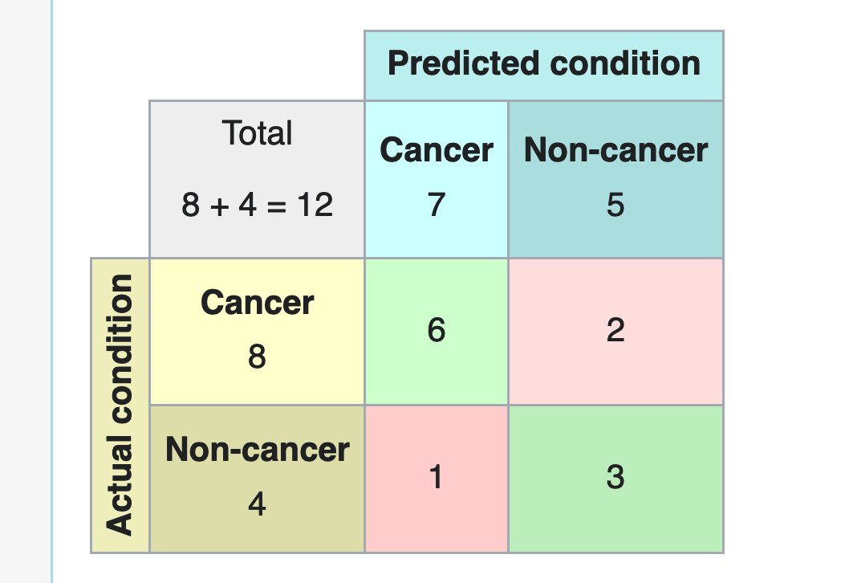

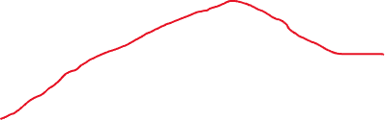
Example: how to show results
Accuracy
100%
75%
50%
1k 2k 4k 8k 16k 32k …
Number of updates (shown on log scale)
Training
Testing
Number of data points, in thousands, at the point when best test results are obtained

Slide 58
Tradeoffs in Machine Learning
Stability-Plasticity Dilemma: keep the old vs. learn the new?
Bias-Variance Tradeoff: how accurate should results on training data be?
Quality of results vs. Computational effort
Exploitation (finding good nearby solutions) vs. Exploration (looking for solutions that are far away)

